Slide 1
Equivalence partitioning
Divides the input data of a software unit into partitions of equivalent data assuming that all the conditions in one partition will be treated in the same way by the software.
We need to test only one condition from each partition.
If one condition in a partition works, we assume all of the conditions in that partition will work, and so there is little point in testing any of these others.
Similarly, if one of the conditions in a partition does not work, then we assume that none of the conditions in that partition will work.

Slide 2
Example Program
A savings account in a bank has a different rate of interest depending on the balance in the account. The rate chart is as following:
0.5% rate of interest is given if the balance in the account is in the range of $0 to $1000
0.75% rate of interest is given if the balance in the account is in the range of $1000 to $10000
1% rate of interest is given if the balance in the account is above $10000
Invalid data | Partition 2 | Partition 3 | Partition 4
Balance <0 | 0 ≤ Balance <1000 | 1000 ≤ Balance< 10000 | 10000 ≤ Balance
Interest = undefined | Interest = 0.5% | Interest = 0.75% | Interest = 1.0%

Slide 3
How not to test?
float calculateSavingsInterest(float balance)
float interestCalc= calculateSavingsInterest(0);
assertEquals(0.0, interestCalc);
float interestCalc= calculateSavingsInterest(500.0);
assertEquals(2.5, interestCalc);
float interestCalc= calculateSavingsInterest(1000.0);
assertEquals(7.5, interestCalc);
float interestCalc= calculateSavingsInterest(2000.0);
assertEquals(15.0, interestCalc);
… … …
float interestCalc= calculateSavingsInterest(5000.0);
assertEquals(37.5, interestCalc);
How many partitions tested?

Slide 4
How to test?
float calculateSavingsInterest(float balance)
try{
float interestCalc= calculateSavingsInterest(-1.0);
fail(“Exception expected”)
}catch(Exception ex){}
float interestCalc= calculateSavingsInterest(100.0);
assertEquals(0.50, interestCalc);
float interestCalc= calculateSavingsInterest(2000.0);
assertEquals(15.0, interestCalc);
float interestCalc= calculateSavingsInterest(20000.0);
assertEquals(200.0, interestCalc);
1
2
3
4

Slide 5
Boundary value analysis
Boundary value analysis is based on testing at the boundaries between partitions
More application errors occur at the boundaries of input domain.
Used to identify errors at boundaries rather than finding those exist in center of input domain.
Invalid data | Partition 2 | Partition 3 | Partition 4
Balance <0 | 0 ≤ Balance <1000 | 1000 ≤ Balance <10000 | 10000 ≤ Balance
Interest = undefined | Interest = 0.5% | Interest = 0.75% | Interest = 1.0%
-0.01 | 0, 0.01, 999.99 | 1000, 9999.99 | 10000

Slide 6
Positive testing
Positive testing validates that an application will work on giving valid input data.
Verifies that the application is NOT showing error when it is not supposed to
What is your phone number?
6184536032

Slide 7
Negative testing
Performed on the system by providing invalid data as input.
Checks whether an application behaves as expected with the negative input.
Ensures that your application can gracefully handle invalid input or unexpected user behavior.
What is your phone number?
xyZ#53()032

Slide 8
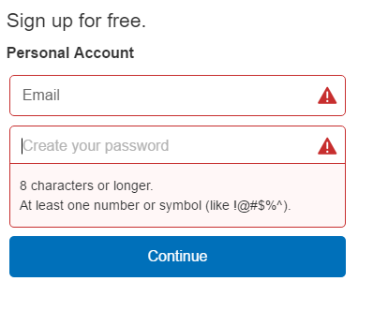
Typical Negative Testing Scenarios
Not populating required fields

Slide 9
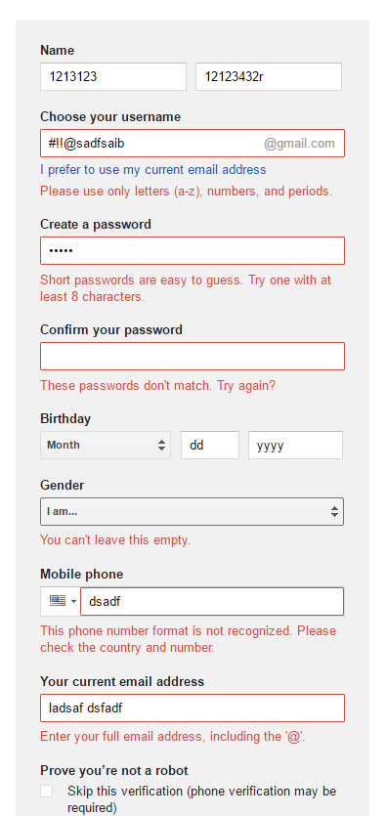
Correspondence between data and field types
Populating fields with incorrect data type

Slide 10
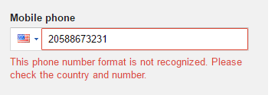
Allowed number of characters
Some applications or webpages may have set maximum / minimum values or number of characters for fields
Create a test that enters more characters into the field than is allowed.

Slide 11
Allowed data bounds and limits
Applications can use input fields that accept data in a certain range
Create a negative test that enters a value smaller than the lower bound or greater than the upper bound of the specified field
Please enter day?
-1
Please enter month?
13

Slide 12
Out of range values
Create test exceeding the bounds of the data types
Integer range:
  -32,768 to 32,767 [2 bytes]
  -2,147,483,648 to 2,147,483,647 [4 bytes]
Float range:
  -3.4E+38 to +3.4E+38

Slide 13
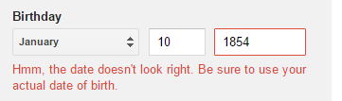
Reasonable data
Check application with unreasonable input data
  Name with 300 characters
  Human Age: 200 years

Slide 14

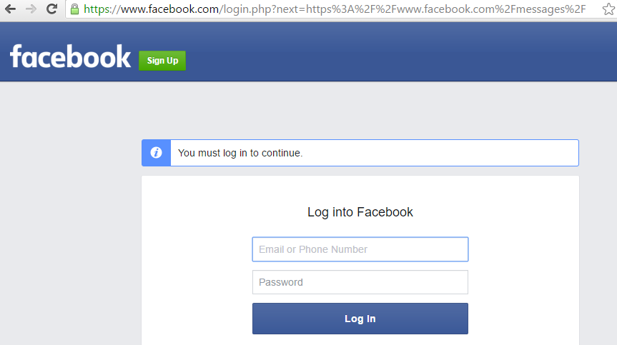
Web session testing
Can we access any URL without logging in?
  Record some of the URL when you were logged in, try those again after you are logged out

